Slide 1
Putting Testing First CS 4501 / 6501 Software Testing

Slide 2
Software Crisis
Programmers just programmed
Result was ad hoc structure
Code eventually became hard to maintain
Managing complexity was challenging
The tendency towards irreducible number of errors
Most software development faced
Overdue schedule
Exceeding initial budget
Inadequate software quality
High software maintenance cost

Slide 3
Planned Design
Heavy reliance on upfront analysis
On time and on budget
Requirements
Analysis
Acceptance
Test
Validation
Test
Design
Information
Architectural
Design
System
Test
Subsystem
Design
Integration
Test
Detailed
Design
Module
Test
Verification
Implementation
Unit
Test
[AO, p.23]

Slide 4
Traditional Cost-of-Change Curve
Traditional software development methods
Focus: extensive modeling and up front analysis
Goal: reveal problems and changes as early as possible
More work must be revised
Cost
Root problem is harder to find
Delta
Time
Original
Revision
[AO, p.55]

Slide 5
Increased Emphasis on Testing
If high-quality testing is not centrally and deeply embedded in your development process,
your project is at high risk for failure
Fail in the technical sense
Lose control of what the code actually does
Fail in the business sense
Your competitors roll out better functionality faster

Slide 6
Traditional Assumptions
Modeling and analysis can identify potential problems early in development
Saving implied by the cost-of-change curve justify the cost of modeling and analysis over the life of the project
These assumptions are true if the requirements are always complete and current
In reality, customers keep changing their mind
Changes reflect the requirements

Slide 7
Supporting Evolutionary Design
Traditional design advice says to anticipate changes
Designers often anticipate changes that don’t happen
Both anticipated and unanticipated changes affect design
Anticipated
Change
Anticipated
change that
doesn’t happen
Evolving
Design
Unanticipated
Change
[AO, Agile Test]

Slide 8
Agile Methods
Agile methods start by recognizing that neither assumption is valid for many current software projects
Software engineers are not good at developing requirements
We do not anticipate many changes
Many of the changes we do anticipate are not needed
Requirements (and other non-executable artifacts) tend to go out of date very quickly
We seldom take time to update them
Many current software projects change continuously
[AO, Agile Test]

Slide 9
Traditional vs. Agile
What does it mean if your design needs to change?
Traditional: Failure in prior design process?
Agile: Normal first class problem in software engineering?
Agile methods expect software to start small and evolve over time
Embraces software evolution instead of fighting it

Slide 10
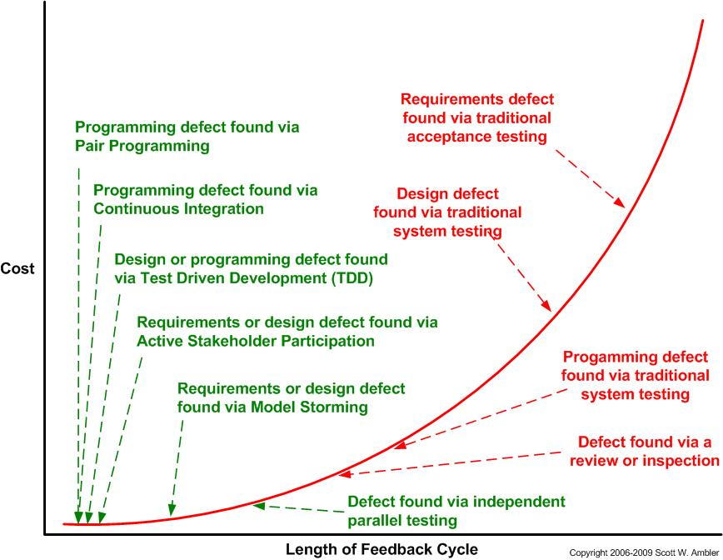
Defect Discovery: Traditional vs. Agile

Slide 11
Managing the Cost Curve
Test harness as guardian
(Near) Instant feedback on changes (or mistakes)
An hour? Ten minutes? Less?
Something is executable from the very beginning
Role of continuous integration
Effective communication mechanisms
De-emphasize non executable artifacts
If it doesn’t execute, it’s not checkable
Avoid anticipating future needs
YAGNI: You Ain’t Gonna Need It

Slide 12
Test Harness as Guardian
What is correctness?
Traditional correctness: universal
Agile correctness: existential
Limit view of correctness
Traditional correctness: define all correct behavior completely at the beginning
Agile correctness: define correctness of some behavior with specific tests
If the software behaves correctly on the tests, it is correct
Even as the software (including the test cases) evolve, the correctness of the system at any single point in time is subject to immediate verification by running the test set.

Slide 13
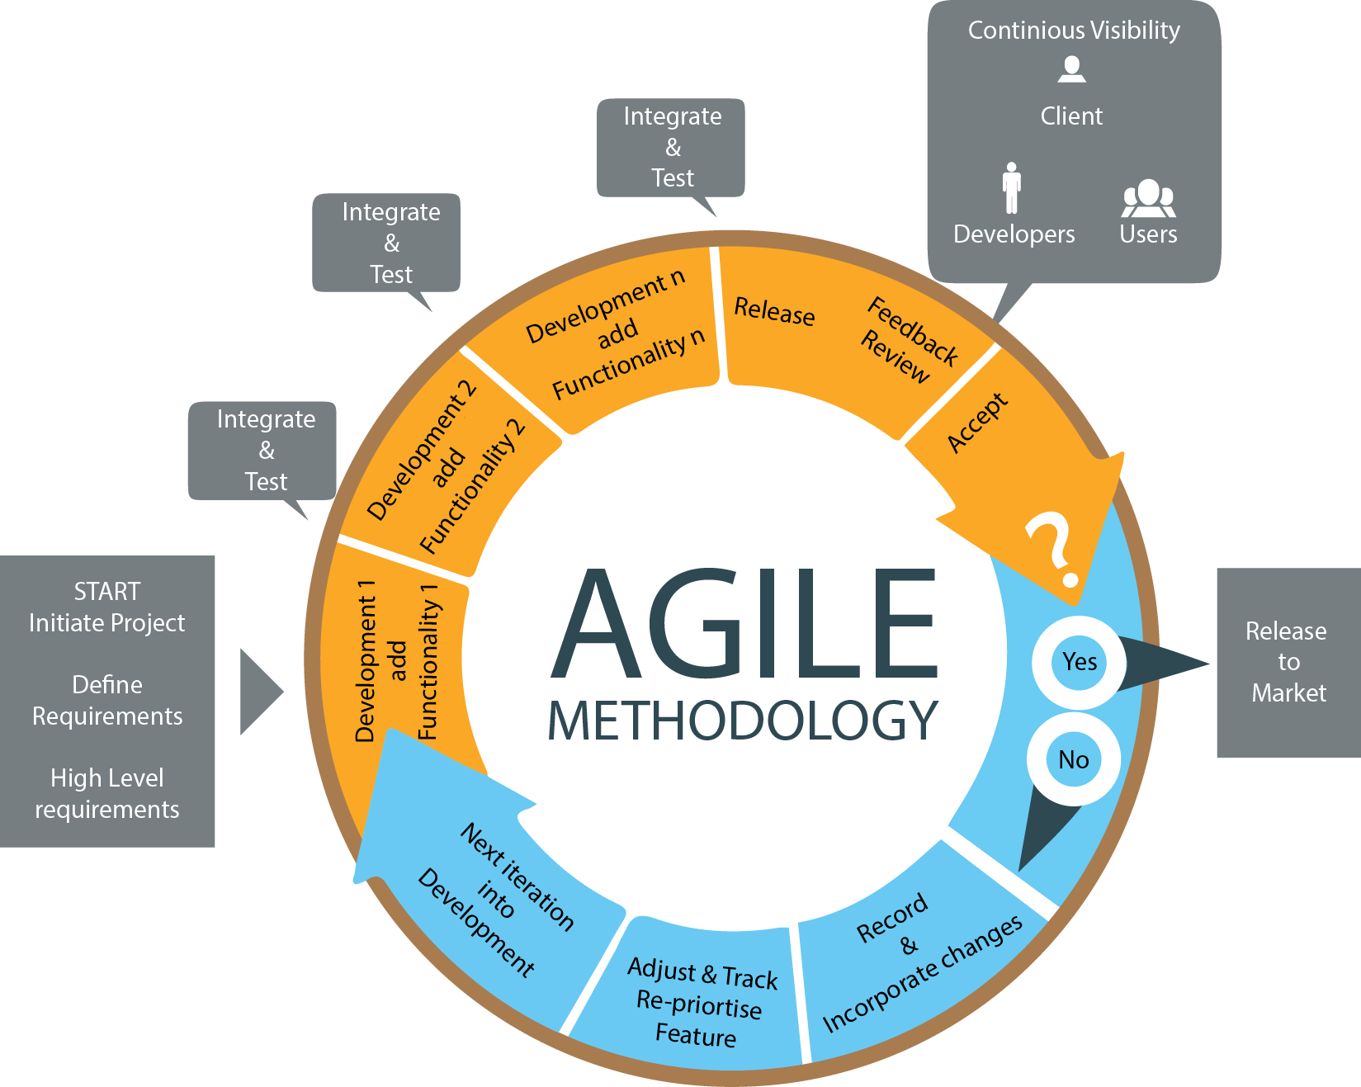
Testing as Central Activity
[image from http://www.twilightsoftwares.com]

Slide 14
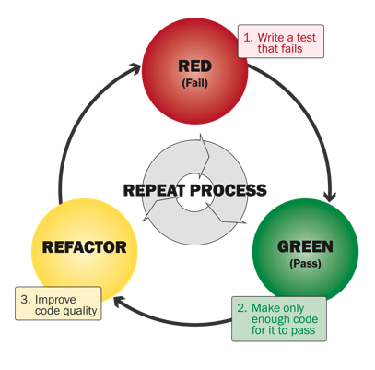
Testing as Central Activity: TDD
[More TDD and exercise .. Later]

Slide 15
Test Harness Verify Correctness
Tests must be automated
Every test must include a test oracle that can evaluate whether that test executed correctly
Tests (executable artifacts) replace the requirements (non-executable artifacts)
Tests must be high quality and must run quickly
We run tests every time we make a change to the software
Test harness runs all automated tests efficiently and reports results to the developers

Slide 16
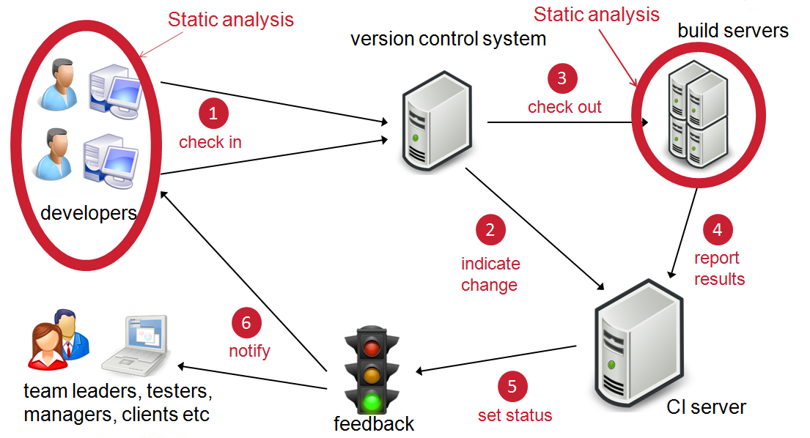
Continuous Integration
Agile methods work best when the current version of the software can be run against all tests at all time

Slide 17
Continuous Integration
A Continuous integration server rebuilds the system, returns, and re-verifies tests whenever any update is checked into the repository
Other developers are aware of changes early
The rebuild and re-verify must happen as soon as possible (tests need to execute quickly)
A continuous integration server doesn’t just run tests, it decides if a modified system is still correct
Mistakes are caught earlier

Slide 18
System Tests in Agile Methods
Traditional testers often design system tests from requirements
What if there are no traditional requirement documents?
Requirements
Requirements
?
System tests
Requirements

Slide 19

User Stories
A few sentences that captures what a user will do with the software
In the language of the end user
Usually small in scale with few details
Not archived
Agent sees a list of today’s interview applicants
Withdraw money from checking account
Support technician sees customer’s history on demand

Slide 20
Acceptance Tests in Agile Methods
User Story
Acceptance Test
(Failing)
TDD Test 1
Change software & Refactor
Tests archived
Acceptance Test
(Passing)
TDD Test 2
Continue adding TDD tests until acceptance test passes
Change software & Refactor
Refactoring avoids maintenance debt
[AO, p.60]

Slide 21
Test Doubles
An object that can stand in for a real object in a test
Stand in for dependencies
Separation of concerns
Replace object with double if real object is
Too slow
Not available
Depends on something that is not available
Too difficult to instantiate or configure for a test
How to test exceptions such as
Dead code?
An unplugged network cable?
How to interact with something that is nondeterministic?

Slide 22
Test Doubles (2)
Stub: simplest possible implementation
Fake: more sophisticated implementation (still hand coded)
Mock: implementation usually generated by tool
Testing for states
Verify how an object listens .. consistency
Testing for interactions
Verify how an object talks to its collaborators
Did the expected methods calls happen in the right order?

Slide 23
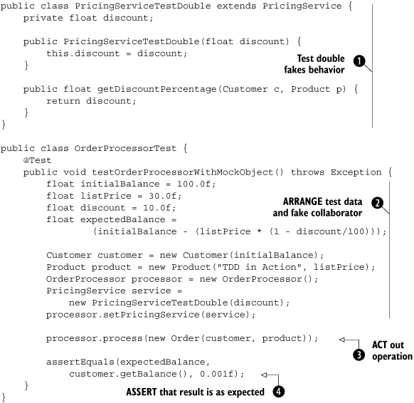
Example Test Double
[Lasse Koskela, Test Driven, p.114]

Slide 24
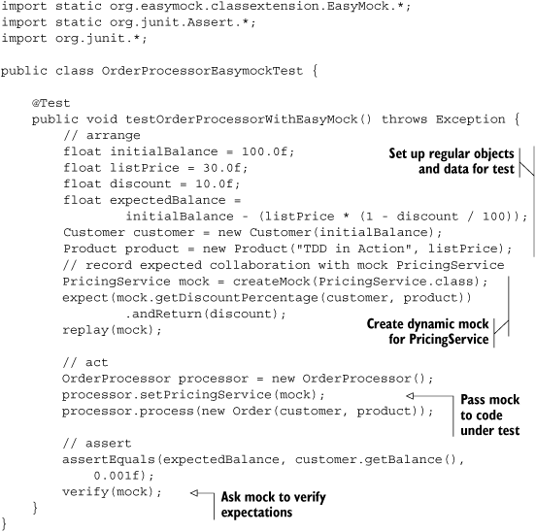
Example Test Double (2)
[Lasse Koskela, Test Driven, p.117]

Slide 25
Summary
More companies are putting testing first
This can decrease cost and increase quality
The definition of “Correctness” becomes restricted but practical
We embrace evolutionary design
We use test harness as guardian
To facilitate the testing process, sometimes we need test doubles.
More TDD and test doubles … later

